Slide 1
Veterinary Services at Chris Richards and Associates
R. Hugo Dunlop BSc, BVSc, MSc, PhD
Chris Richards and Assoc

Slide 2
Veterinary Services - Pigs
Emphasis on Detailed Involvement
Communication Channels
Training and Quality Assurance
Surveillance Systems
Management Systems
Problem Definition & Solutions
Industry Representation
Research and Development

Slide 3
Emphasis on Detailed Involvement
Understand clients business model
Short, Medium & Long-term goals
Production System And Size
Determine Potential & Opportunities & Strengths
Potential Threats And Weaknesses
Understand resources available and constraints
Time – People (include training) - Resources
Economics and Cash-flow
Selling option software
Priority setting - health / production - CIP

Slide 4
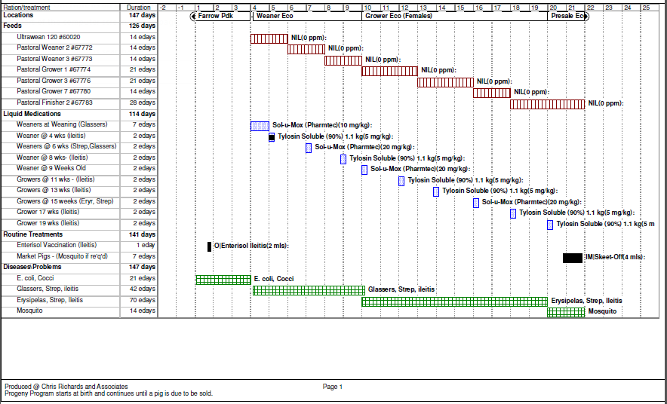
Veterinary Health Plan

Slide 5
Streptococcus suis
Increasing problem in weaners and growers.
No commercial vaccine available.
Known to be many serotypes of Strep suis.
Efficacy of autogenous vaccines generally regarded to be poor.
Alternative control based on amoxycillin
Studies conducted to determine genetic variability of pathogenic isolates

Slide 6
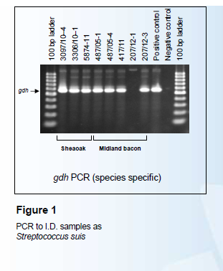

Streptococcus suis confirmation and genetic similarity
Confirmation of S. suis - presence of ‘gdh’ gene.
One isolate found to not be S. suis.

Slide 7
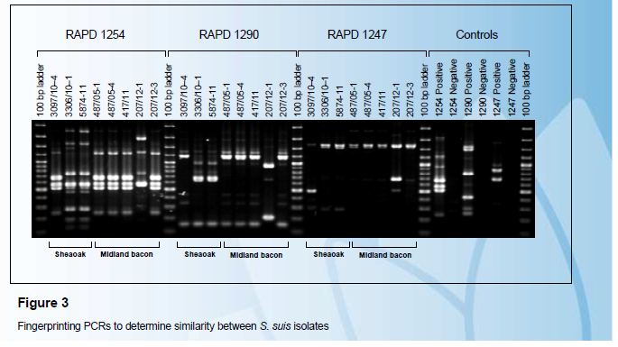
Strep suis similarity - RAPD

Slide 8
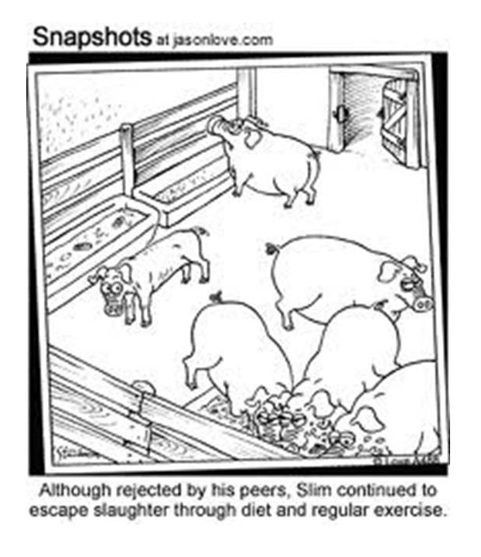
Thank you for your attention!
And as a reward, some humour ….

Slide 9
Livestock Management Act
Purpose: to regulate livestock management in Victoria
Welfare of Pigs : Victorian Standards and Guidelines adopted into Regulations of this Act.
Pigs must be cared for by personnel who are skilled in pig husbandry and are suitably qualified to maintain health and welfare of animals.
Also requirement to conduct Systematic Risk Assessment
What is suitably skilled and qualified?
CRA Approach - vets conduct on farm training of staff which is assessed and documented for stock persons.
In addition, CRA developing a supplementary tool to assist in maintaining competency based on scenarios on the farm.

Slide 10
CRA Piggery College
Internet-based integrating the powers of multimedia using You Tube (video) and Jarcasa (images).
Multiple-choice based assessments.
Utilise simulated or real life scenarios to assist staff induction and training.
It tries to be engaging with its participants.
We believe this type of tool has potential in a wide range of businesses.
Examples
  what is a pig
  Sow intake problem
  Pregnancy Testing

Slide 11
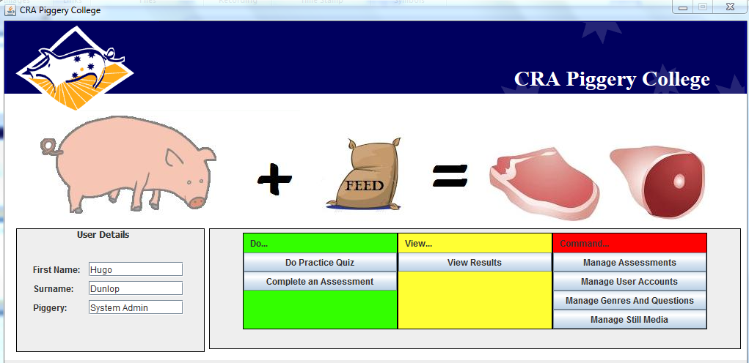
CRA Piggery College Menu

Slide 12
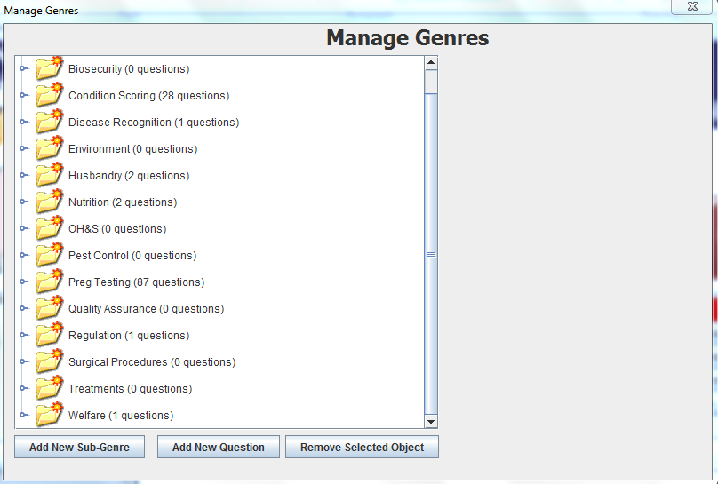

Slide 13
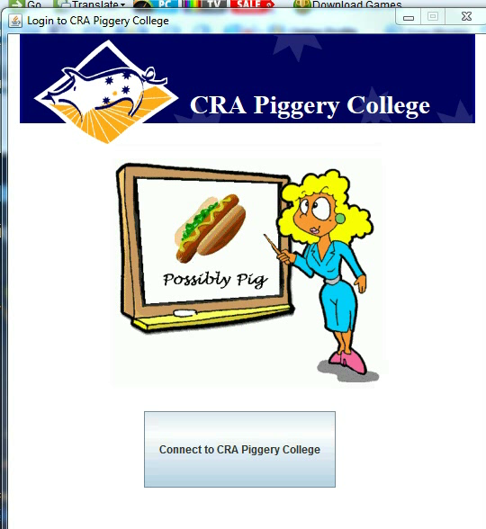
What is a Pig?

Slide 14
Sow Appetite Problem

Slide 15
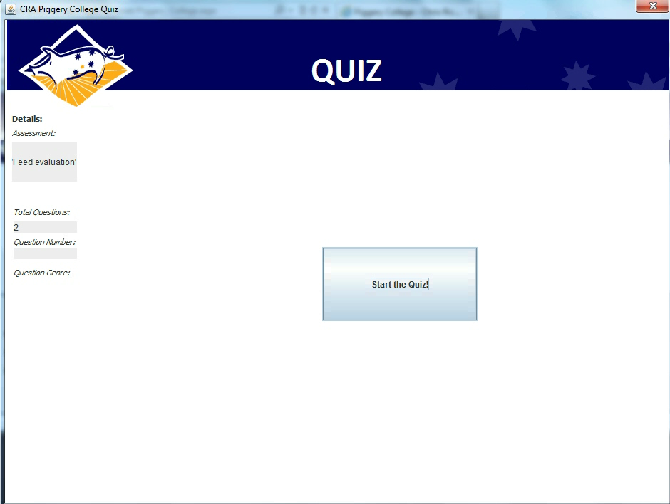

Slide 16
Competency in Real-Time Pregnancy Testing

Slide 17


Slide 18
Conclusions
Hopefully this approach will help us improve the welfare and production of our production animals.
We are keen to hear if anyone sees any other additional application(s) of this approach.

Slide 19
Thank you for your attention!
And as a reward, some humour ….

Slide 20
